Slide 1

CSE201
Advanced Programming
Akhilesh Reddy (2019230)
Yatharth Taneja (2019346)

Slide 2
DESIGN AND IMPLEMENTATION
Softwares Used: IntelliJ and Scene Builder
Version Control System: GIT and GITHUB
All the assets are self made either by coding in Javafx or by making individual images/ animation in adobe Illustrator and photoshop
Over 33 different classes interacting and playing along
Using Facade, Flyweight Pattern, Observer, Strategy, State design patterns
The UI is both statically managed by FXML and dynamic by JavaFX
Used polymorphism, inheritance, serialization, encapsulation, inner classes OOP Principles

Slide 3
Problems Faced
P. Initial problems in collaboration
S. Learned Git together with few temporary files
P. Connecting FXML and different stages
S. Discovered similar problems and found out a way to pass reference to keep the same stage throughout
P. Fxml obstacles would not allow us to use OOPS properly and we couldn’t create algorithm for difficulty with FXML
S. Made similar obstacles by ourselves through coding and applying lots of maths for accuracy
P. JavaFx objects cannot be serialised
S. Implemented additional data structures to store the references , positions , obstacle types etc
P. General queries regarding javafx and ways to solve
S. Took reference from manpages , tutorialspoint and learned how to resort our issues

Slide 4
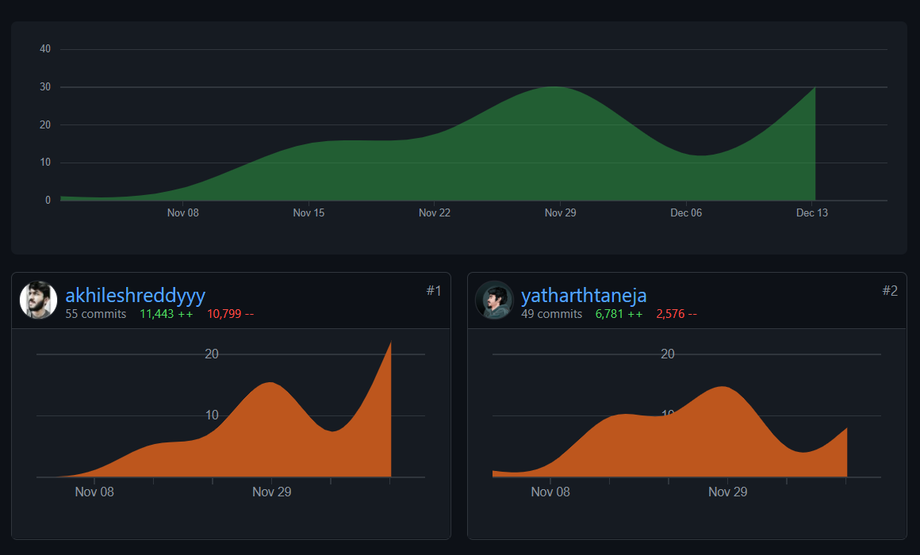
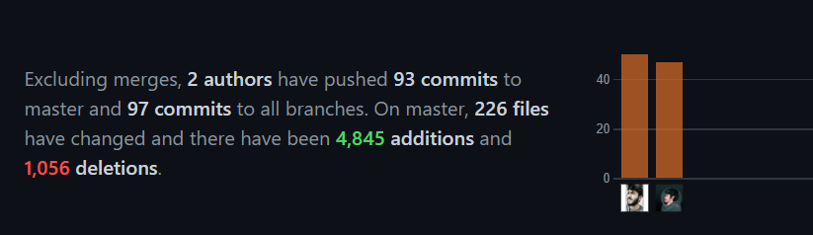
Individual Contribution
The work was split uniformly between us.
Split the work on the basis of UI layers and functionality.
Initially Yatharth handled most of the UI part along with movement of obstacles and Akhilesh handled majority of the integration along with the game play.
For the remaining work, both of us contributed equally in every function and the credit cannot go to any one single person, which can be seen in our commit history and for the rest of the work, we interacted through screen share and helped each other out and coded together.
The commit history can be seen in our github profile, and link for the same has been attached.

Slide 5
BONUS
Exclusive Light Mode, with a lighter background and dark buttons. (it makes the game more interesting for the users to play ;))
Cheatcodes? Press the H key for secret Developer Mode where you cannot die ;)
Background music and individual sound effects for every action/ button as in the original game with the ability to mute them separately in settings
Subtle animations like a blinking star , +1 on collection of star , bursting of ball on death.
Over 10 different obstacles with fluid animation.
Option to Reset Data, like highscore , total stars and all the saved games

